Slide 1

Note: The data and information in this document is reflective of a hypothetical situation and client. This document is to be used for KPMG Virtual Internship purposes only.
Sprocket Central Pty Ltd
Data analytics approach
Eden Grandclaude

Slide 2
Note: The data and information in this document is reflective of a hypothetical situation and client. This document is to be used for KPMG Virtual Internship purposes only.
Agenda
Introduction
Data Exploration
Model Development
Interpretation

Slide 3
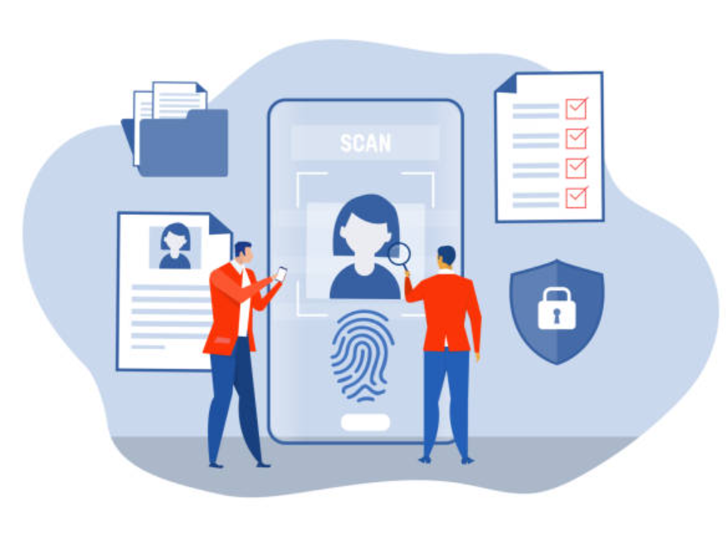
Note: The data and information in this document is reflective of a hypothetical situation and client. This document is to be used for KPMG Virtual Internship purposes only.
Introduction
Identifying customers is key to success
Helps identify customers that adds the most value to the company.
Improves customer satisfaction.

Slide 4
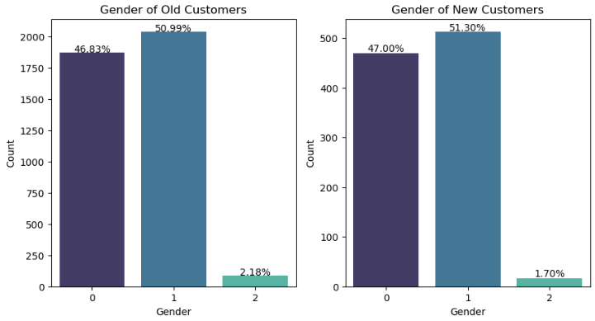
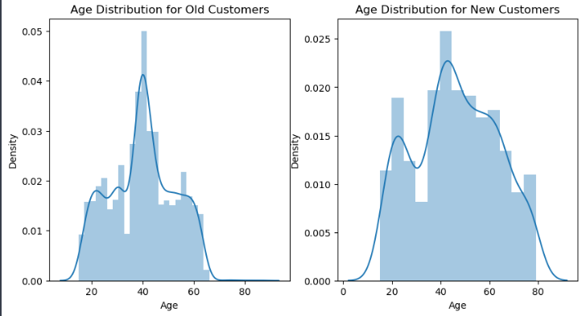
Note: The data and information in this document is reflective of a hypothetical situation and client. This document is to be used for KPMG Virtual Internship purposes only.
Data Exploration
Customer Demographic
Gender:
The majority of new and existing customers are women.
Age:
Most of the old customers are around 40 years old.
Most of the new customers are around 50 years old and the distribution of age is more spread out.

Slide 5
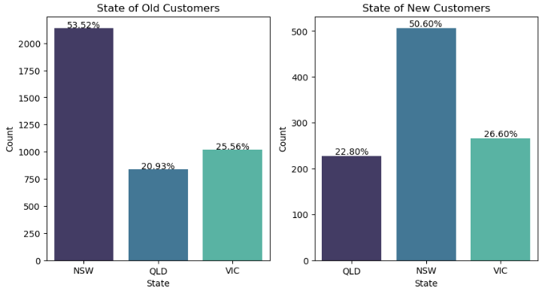
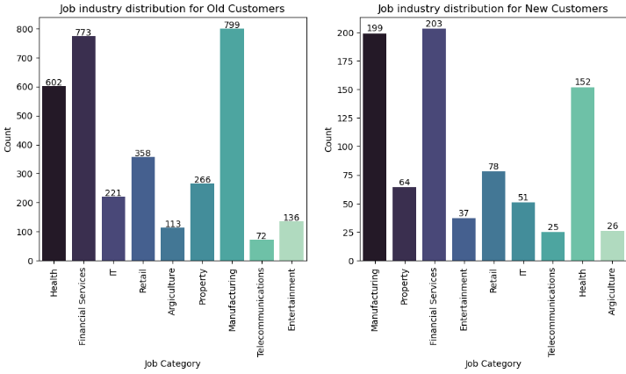
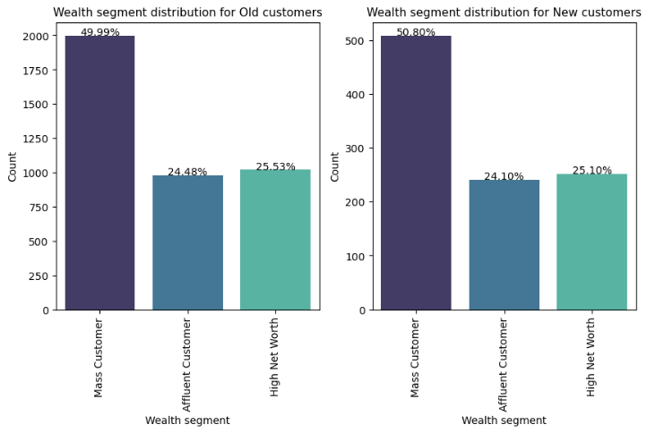
Note: The data and information in this document is reflective of a hypothetical situation and client. This document is to be used for KPMG Virtual Internship purposes only.
Data Exploration
Job industry category:
Most customers work in manufacturing, health and financial services.
State:
Over 50% of new and existing customers come from NSW.
Wealth Segment:
Most customers belong to the ‘mass customer’ segment.

Slide 6
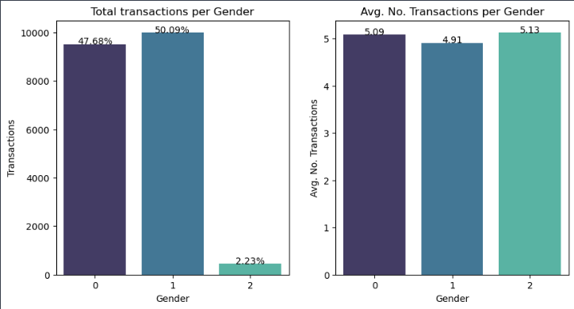
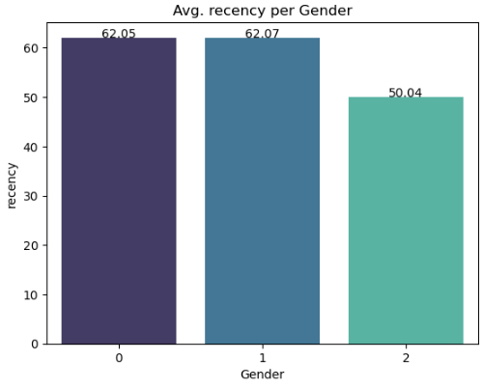
Note: The data and information in this document is reflective of a hypothetical situation and client. This document is to be used for KPMG Virtual Internship purposes only.
Model Development
RFM Analysis
The Recency, Frequency, Monetary analysis is useful to identify and categorise customers based on their past behaviours.
Therefore, this enables the company to target customers in order to increase its value.
Female customers tend to have a slightly higher average recency comparing to male customers, and a higher total number of transactions.
Men tend to have a higher average number of transactions.

Slide 7
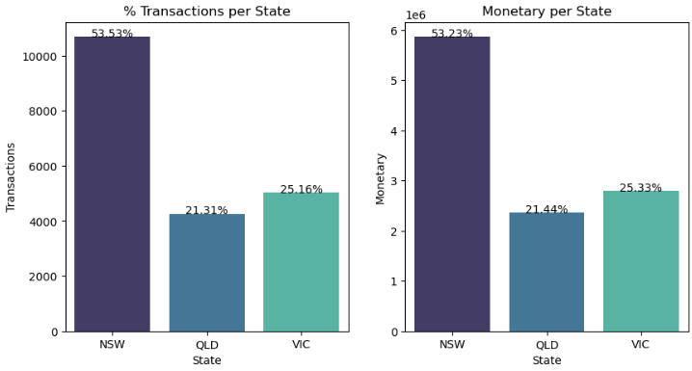
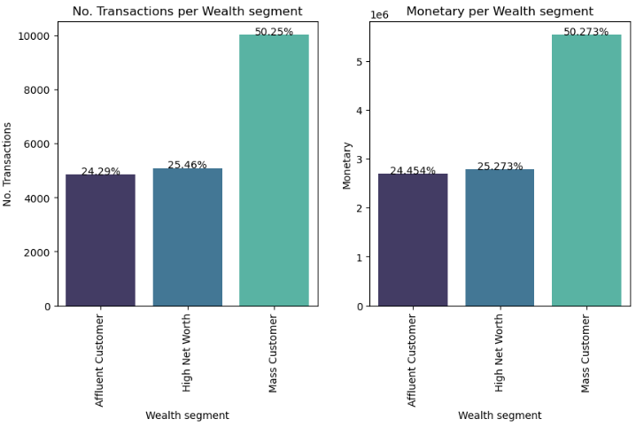
Note: The data and information in this document is reflective of a hypothetical situation and client. This document is to be used for KPMG Virtual Internship purposes only.
Model Development
RFM Analysis
NSW state has the highest total number of transactions and the highest monetary percentage.
Mass customer tend to have a higher number of total transactions and higher monetary percentage.

Slide 8
Note: The data and information in this document is reflective of a hypothetical situation and client. This document is to be used for KPMG Virtual Internship purposes only.
Interpretation
Customer Identification
Identify customers that buy often and spend most.
Create dashboard

Slide 9
Note: The data and information in this document is reflective of a hypothetical situation and client. This document is to be used for KPMG Virtual Internship purposes only.
Thank you!

